Slide 1
MACHINE LEARNING AS A SERVICE
INFO7390 15974 Advances Data Sci/Architecture
By
Abhinav Tiwari
Dharit Shah
Nilesh Nerkar
(Team 2)

Slide 2
Agenda
Machine Learning Pipeline
MLAAS
How MLaaS make it easy?
Available Machine Learning Services
Azure ML Studio
What is Amazon SageMaker?
H2O (AutoML)

Slide 3
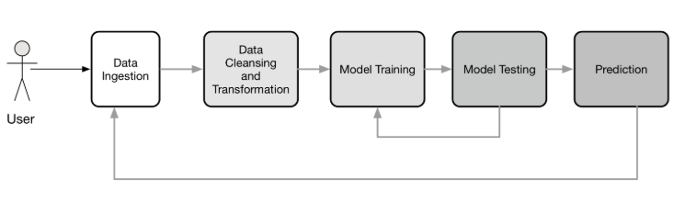
Machine Learning Pipeline

Slide 4
Machine Learning As A Service
The same as SaaS or BaaS solutions, machine learning as a service platforms are intended to handle nearly all matters connected with infrastructure
Developers are not obligated to messing with model training and evaluation, as well as worry about further cloud-based predictions
MLaaS makes it easy and automate the pipeline depending upon the service which we use

Slide 5
Available Machine Learning Services
Azure Machine Learning
Amazon Machine Learning
H2O AI
Databricks
Google Prediction API
IBM Watson
TensorFlow

Slide 6
What is Azure ML Studio?
Azure ML is a visual interface contributing to model building and training, as well as choosing algorithms to apply
The service itself is focused around the ML Studio framework that allows you to create modular solutions
No Software to install, only web browser is needed
Possibility to develop without writing code
Easy deployment and usage using Rest API
Easy collaboration on Azure ML projects

Slide 7
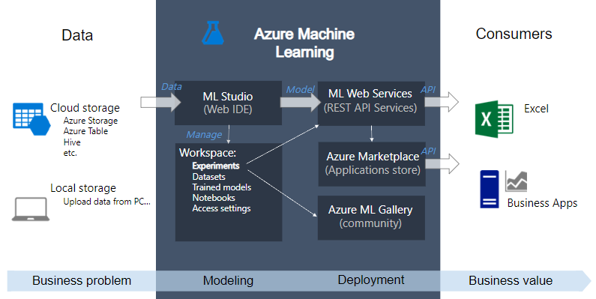
Overview Azure ML Studio

Slide 8
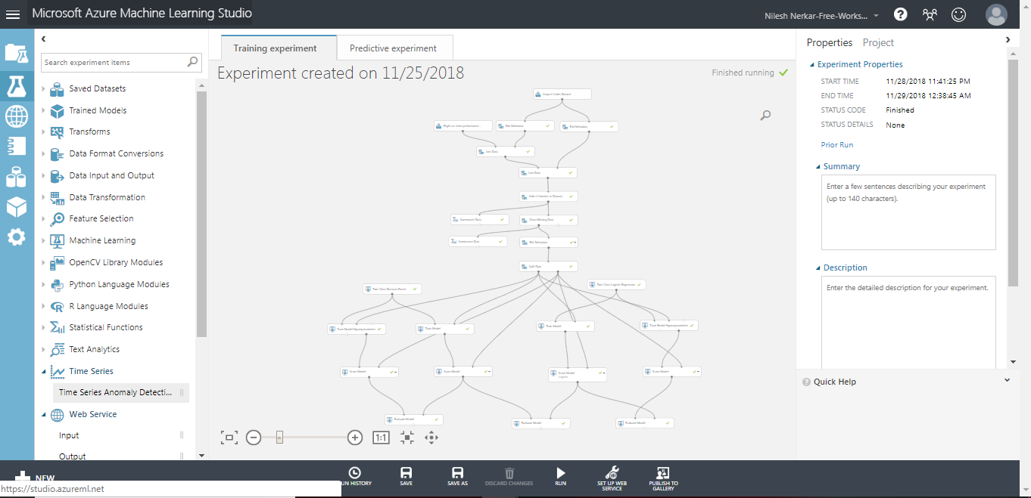
Azure ML Studio Demo

Slide 9
Limitations in Azure ML Studio
Maximum storage volume per account is limited
Maximum dataset volume is 10 GB
Throttled Policy is that only 20 concurrent request per endpoint, max endpoint count 10K
Its like a Black Box, no debug, no scala, C++, C#
One should know their own right algorithm to be used

Slide 10
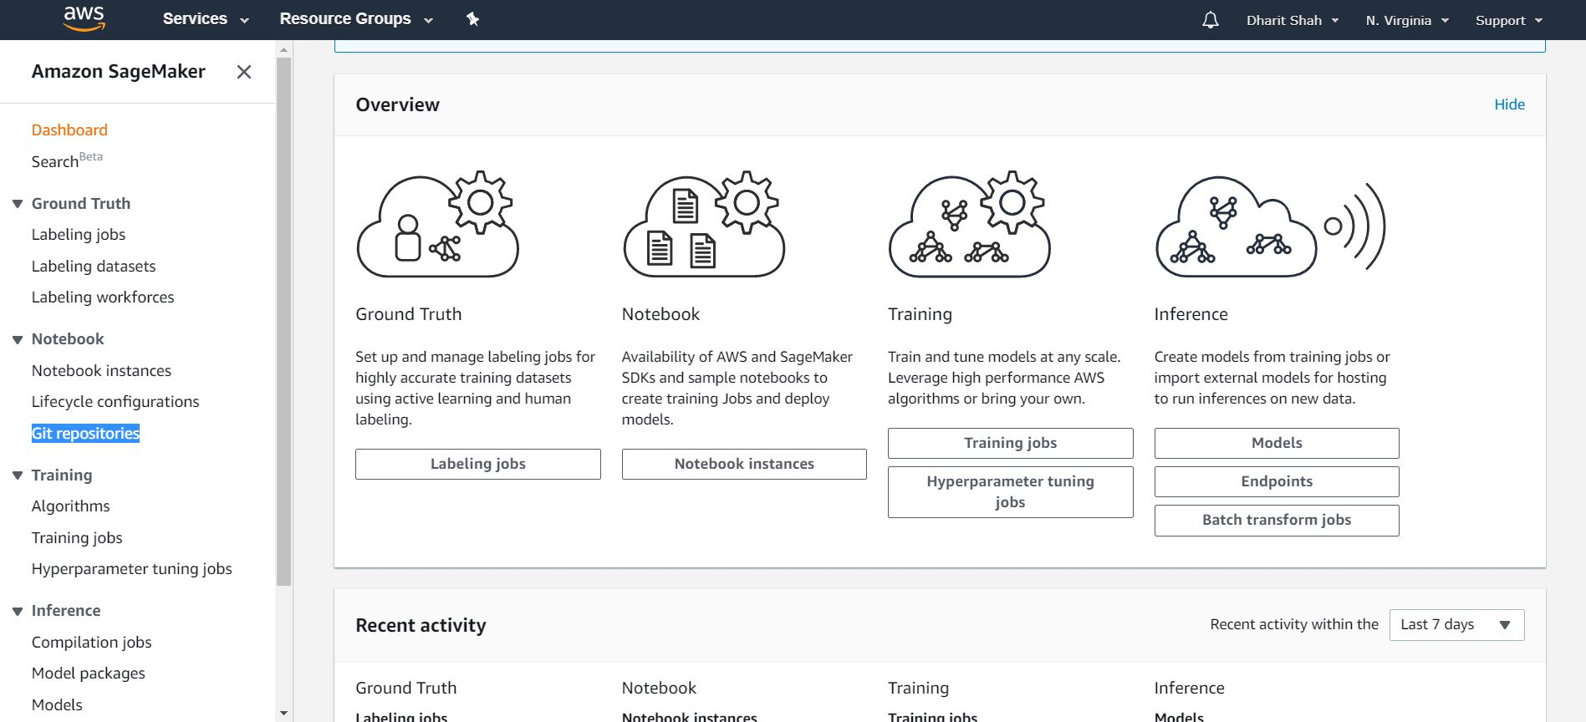
What is Amazon SageMaker?

Slide 11
Amazon SageMaker Features
Build
Build highly accurate training datasets
Managed Notebooks for Authoring Models
Built-in, High Performance Algorithms
Broad Framework Support
Broad Framework Support
Train
One-click Training
Automatic Model Tuning Broad Framework Support
Train Once, Run Anywhere
Deploy
One-click Deployment
Automatic A/B Testing
Fully-managed Hosting with Auto Scaling

Slide 12
Amazon SageMaker Demo

Slide 13
H2O AI Description

Slide 14
H2O AI
Pros:
Model Selection
Model Validation

